Slide 1
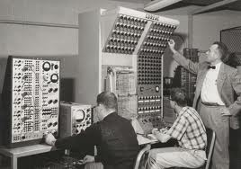
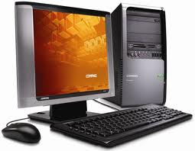
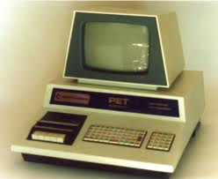
FIVE GENERATIONS OF COMPUTERS

Slide 2
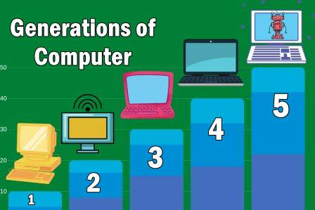
Contants
generation of computer
First Generation Computers
Second Generation Computers
Third Generation Computers
Fourth Generation Computers
Fifth Generation Computers

Slide 3
Generations of Computer
The computer has evolved from a large-sized
Simple calculating machine to a smaller but much more powerful machine.
The evolution of computer to the current state is defined in terms of the generations of computer.
Each generation of computer is designed based on a new technological development.

Slide 4
Generations of Computer
Currently, there are five generations of computer.
In the following subsections,
we will discuss the generations of computer in terms of the technology used by them
hardware and software,
Computing characteristics
speed

Slide 5
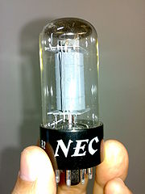
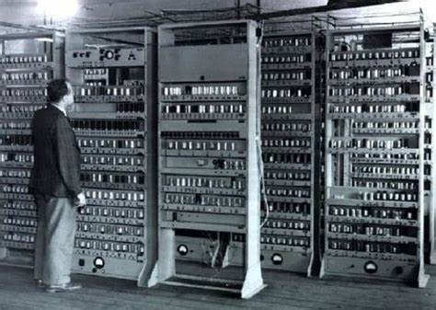
First Generation Computers (1940-1956)
The first computers used vacuum tubes for circuitry.
Magnetic drums for memory.
They were often enormous and taking up entire room.
First generation computers relied on machine language.
Examples:
UNIVAC computers
ENIAC computers

Slide 6
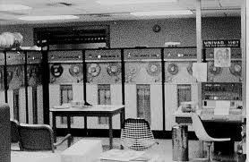
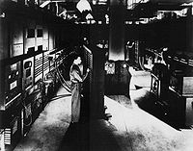
First Generation Computers
Advantages :
It was only electronic device
First device to hold memory
Disadvantages :
Too bulky i.e large in size
Vacuum tubes burn frequently
They were producing heat
Maintenance problems

Slide 7
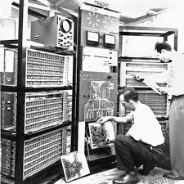
Second Generation Computers (1956-1963)
Transistors replaced vacuum tubes
High-level programming languages were also being developed at this time,
such as
COBOL
FORTRAN.
These were also the first computers that stored their instructions in their memory.

Slide 8
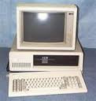
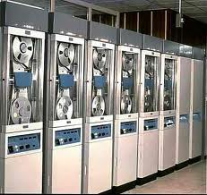
Second Generation Computers
Advantages :
Size reduced considerably
The very fast
Very much reliable
Disadvantages :
They over heated quickly
Maintenance problems

Slide 9
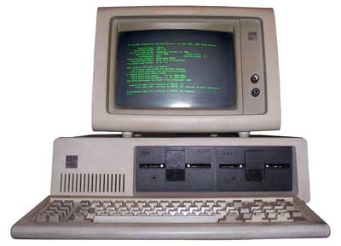
Third Generation Computers (1964-1971)
The development of the integrated circuit.
Transistors were miniaturized and placed on siliconchips, called semiconductors.
Users interacted with third generation computers through keyboards and monitors and interfaced with an operating system.
Allowed the device to run many different applications at one time.

Slide 10
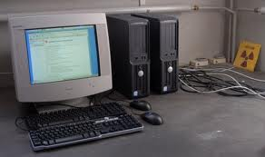
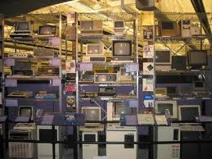
Third generation computers
Advantages :
ICs are very small in size
Improved performance
Production cost cheap
Disadvantages :
ICs are sophisticated

Slide 11
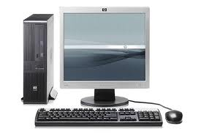
Fourth Generation Computers (1971-present)
The microprocessor brought the fourth generation of computers
The Intel 4004 chip, developed in 1971
From the central processing unit and memory to input/output controls—on a single chip.

Slide 12
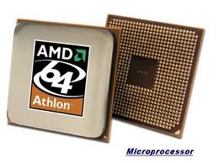
Fourth Generation Computers

Slide 13
Fifth Generation Computers
this generation is based on parallel processing hardware and IA
5th Generation of computer is based on Artificial Intelligence.
Google search engine also uses this technology.
X

Slide 14
Fifth Generation Computers
Includes the various terms in artificial intelligence which are given below:
Robotics.
Neural Networks.
Game playing.
Natural language processing.
Develop the expert system to decide a real-life situation.

Slide 15
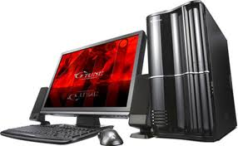
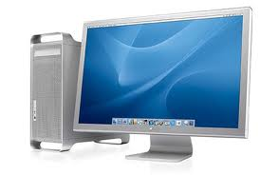
Fifth Generation Computers

Slide 16
THANK YOU

